Slide 1


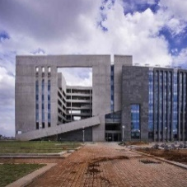

Finite Element Methods Lab
Elastic-Plastic Finite Element Analysis of Deep Drawing of a square cup
Dept. of Mechanical & Aerospace Engineering, IIT Hyderabad
Course Instructor: Dr. Muvvala Gopinath
BARATH.I
ME25MTECH11002
Department of Mechanical & Aerospace Engineering, IIT Hyderabad
0

Slide 2
Finite Element Analysis of Deep Drawing of a square cup
Blank size: S_{p}= 124 mm, thickness t₀= 1 mm
Punch size: S_{p}= 70 mm, punch profile radius: r_{pp}= 8 mm, corner radius: r_{pc}= 10 mm
Die size: S_{d} = 74 mm, profile radius: r_{dp}= 5 mm, corner radius: r_{dc}= 12 mm
For cold rolled steel σ = YS+K(ε)^{n} MPa
Yield stress = 276 MPa, Strain Hardening exponent (n) : 0.8, Strength coefficient (K) ; 421 MPa
E = 210000 MPa, ν = 0.33
Coefficient of friction = 0.05
1
Department of Mechanical & Aerospace Engineering, IIT Hyderabad

Slide 3
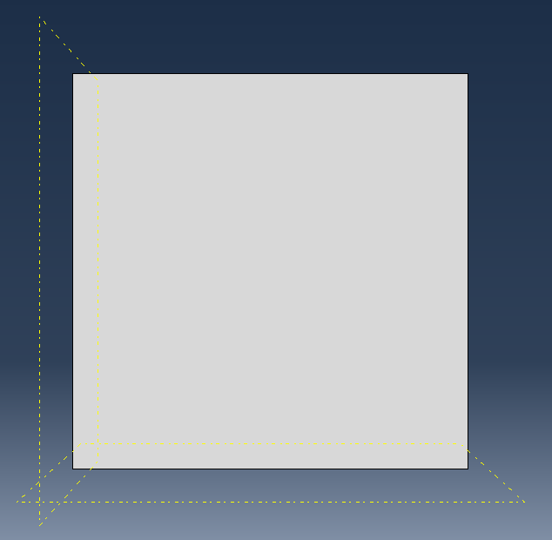
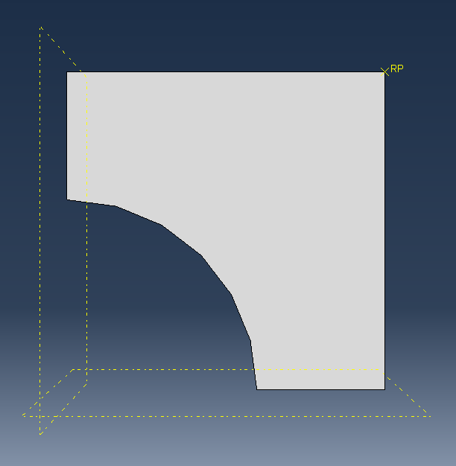
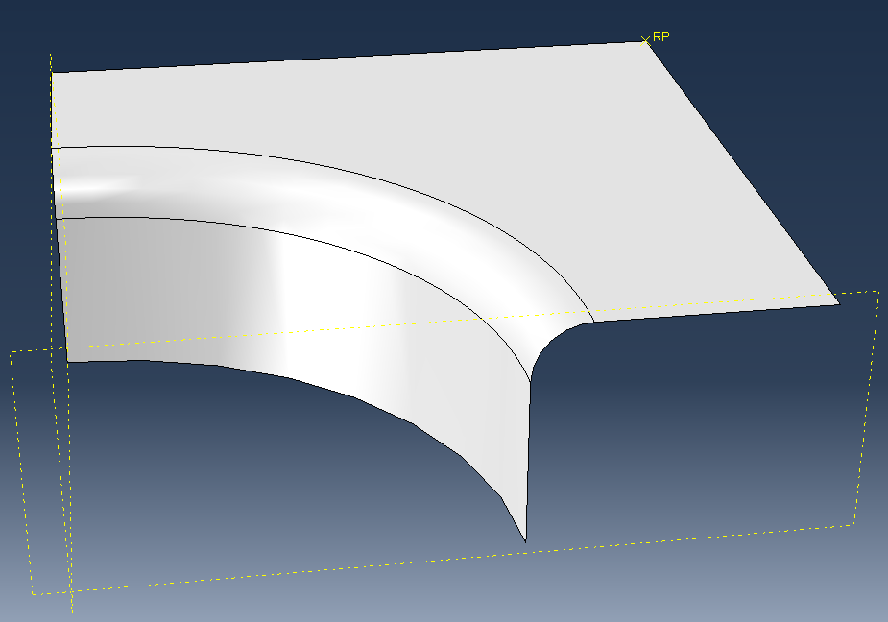
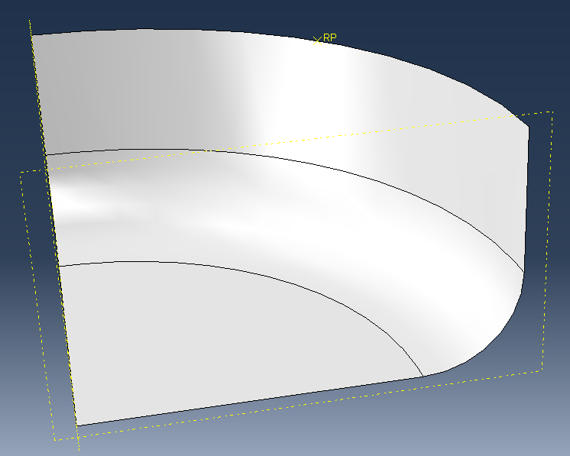
PARTS
BLANK HOLDER
DIE
SHEET
PUNCH

Slide 4
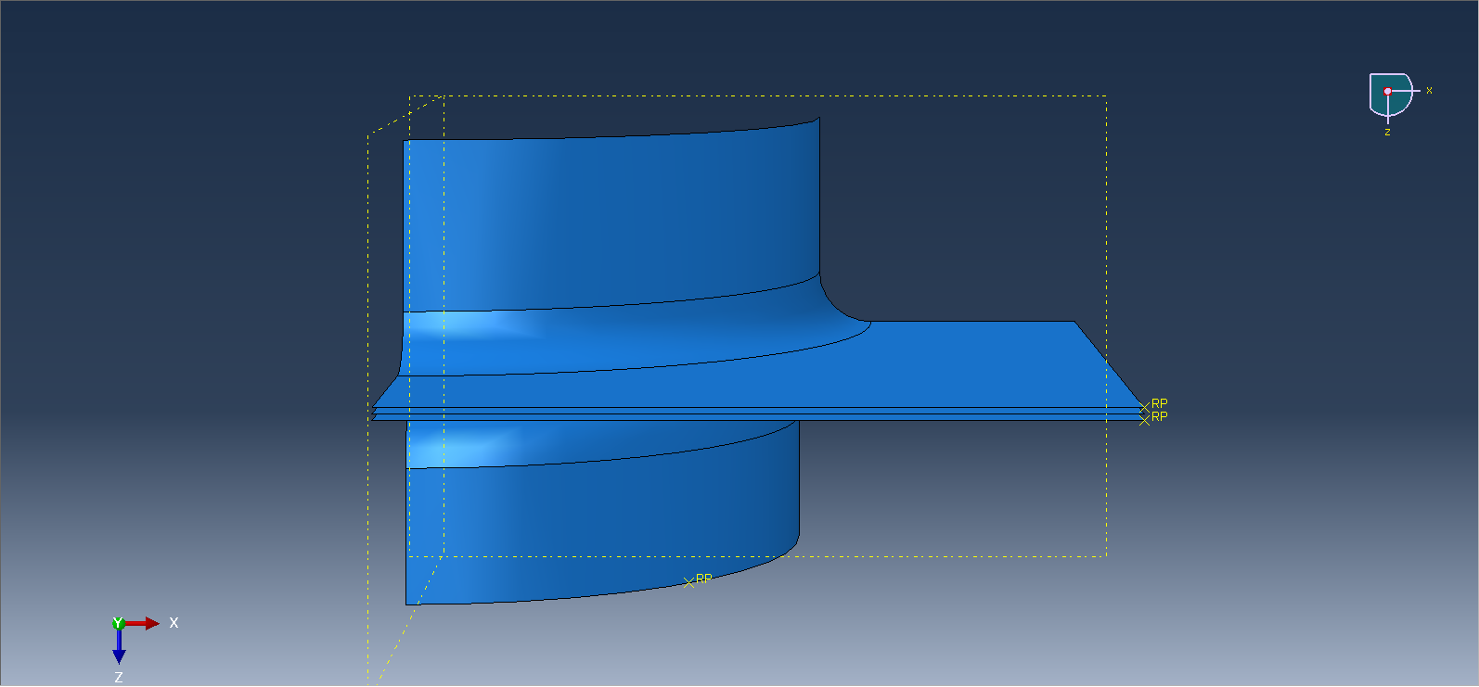
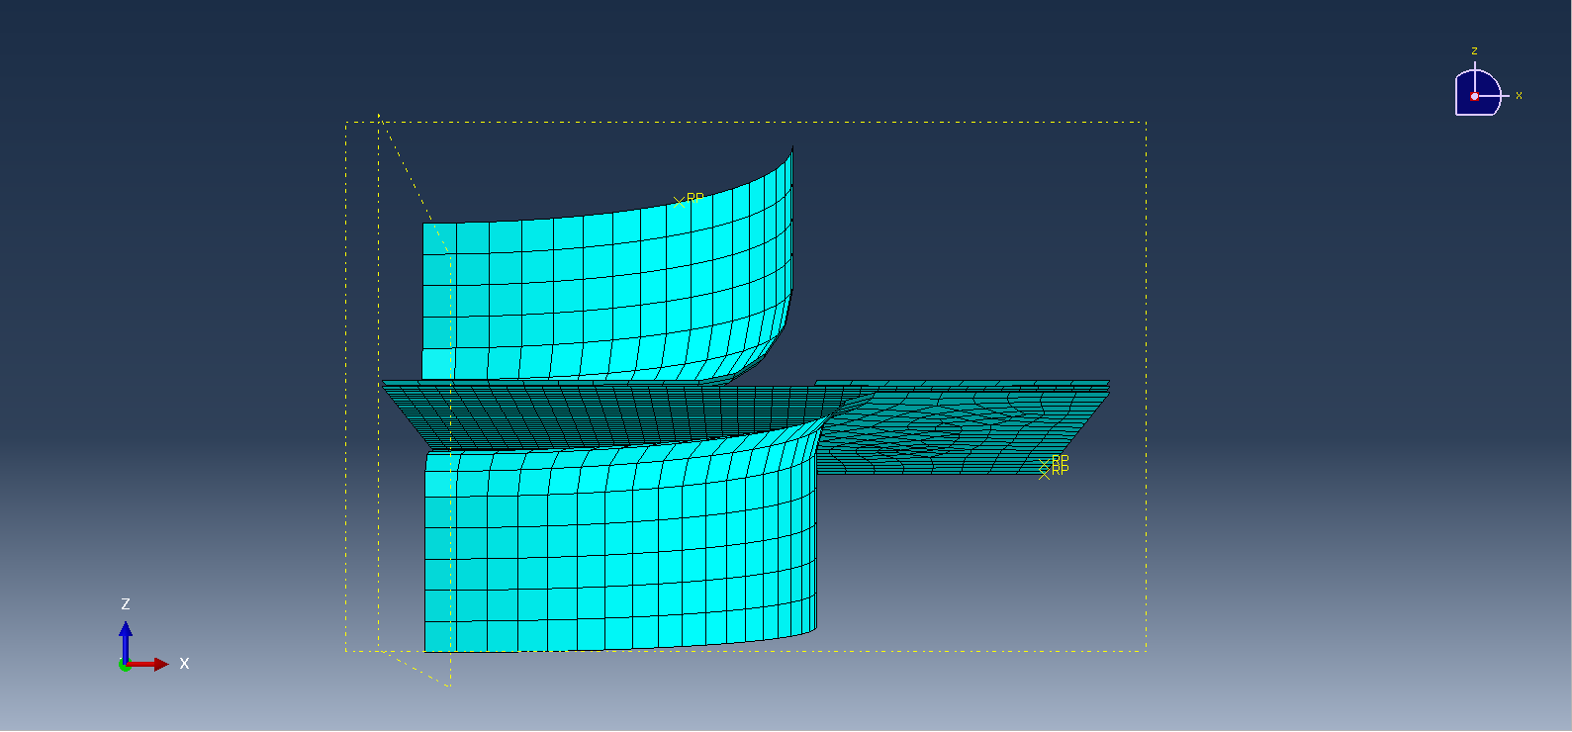
ASSEMBLY

Slide 5
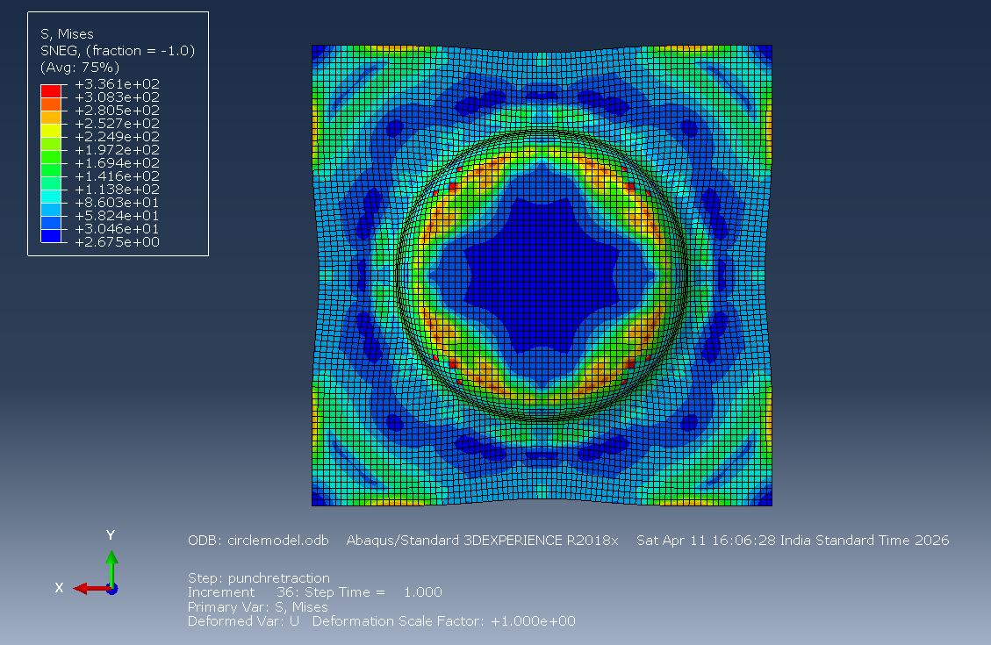
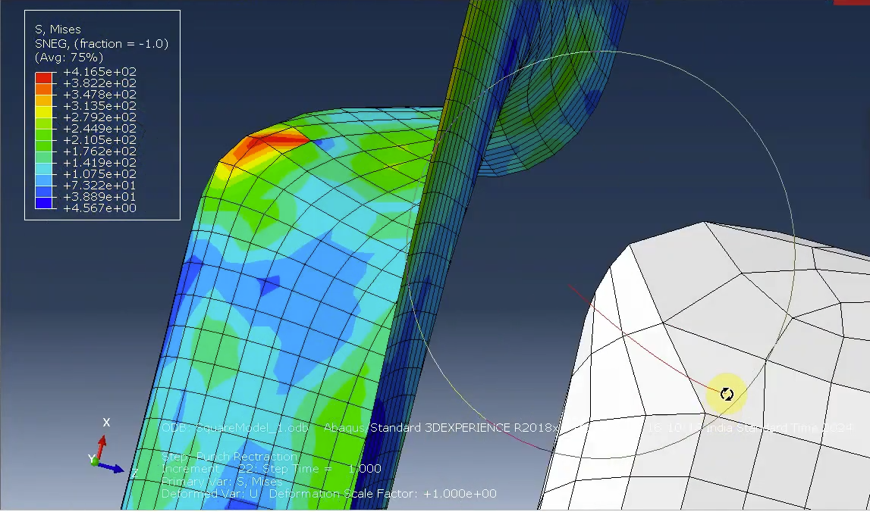
1) EFFECT OF PUNCH GEOMETRY ON THE ANALYSIS OF DRAWING
STRESS CONCENTRATION USING CIRCULAR PUNCH
STRESS CONCENTRATION USING SQUARE PUNCH
MAX VALUE :336.1 MPA
MAX VALUE :416.5MPA

Slide 6
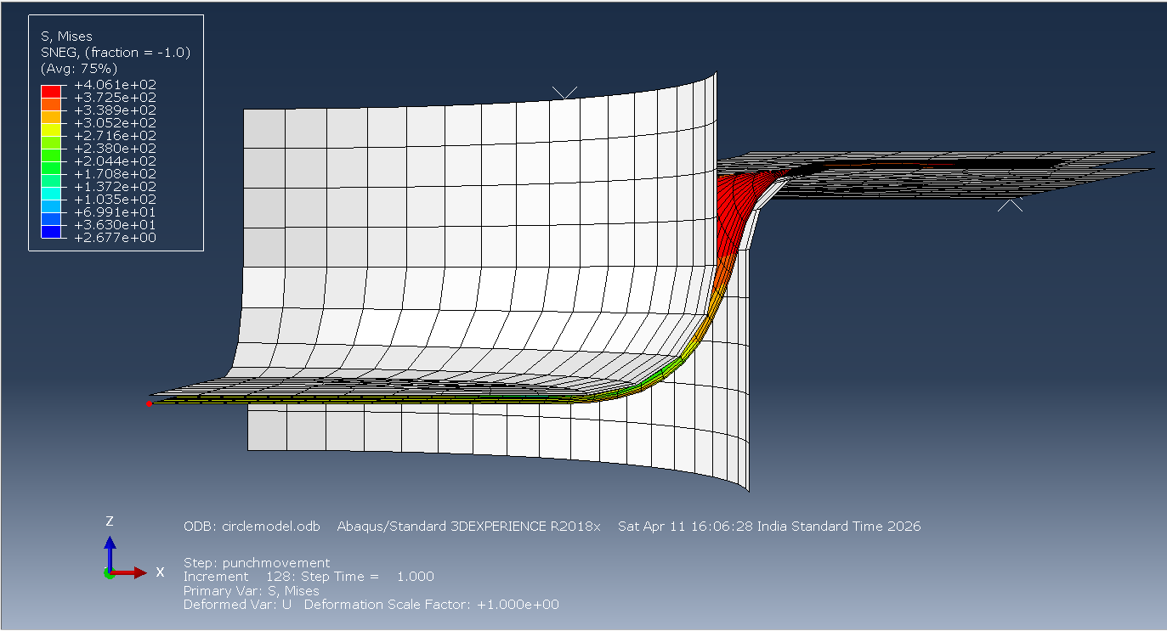
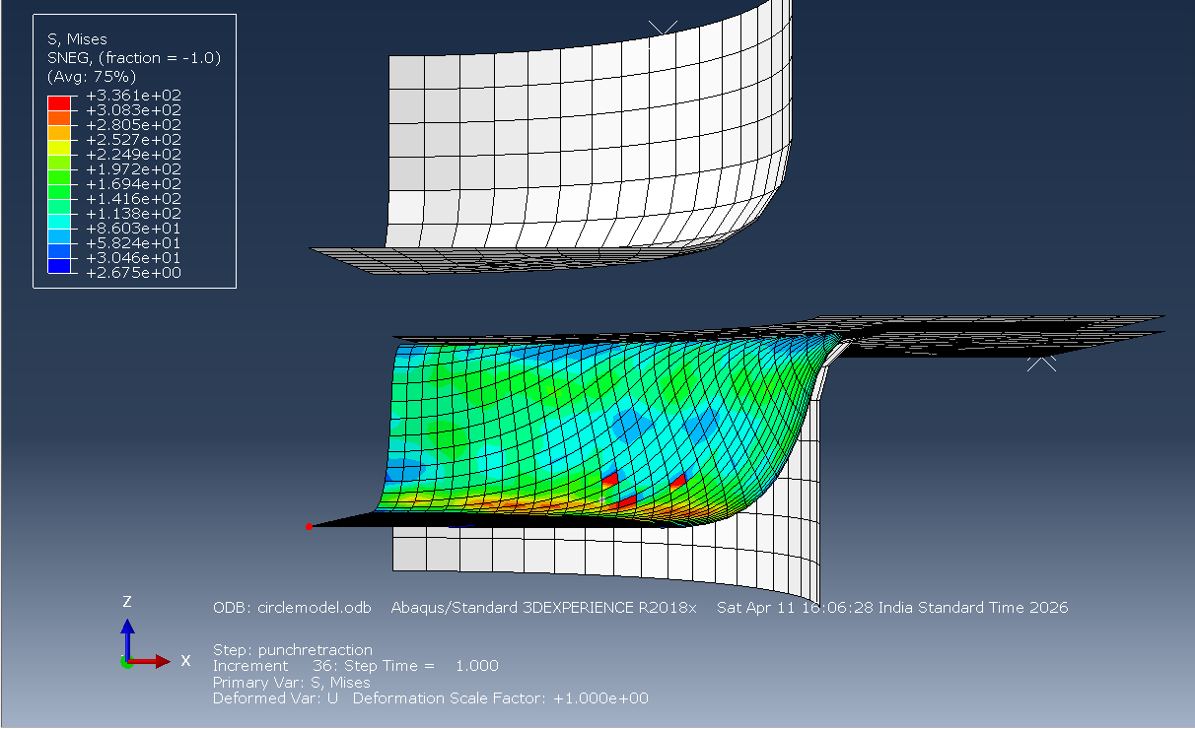
SPRING BACK EFFECT
DEFORMATION AT THE END OF PUNCHING
DEFORMATION AFTER RETRACTION OF PUNCH

Slide 7
LOAD | MAXIMUM DEFORMATION | DEFORMATION AFTER PUNCH REMOVAL | SPRING BACK
5000 N | 15.06 | 14.6 | 0.46
10000 N | 15.02 | 14.7 | 0.32
15000 N | 14.9 | 14.6 | 0.3
20000 N | 15.02 | 14.69 | 0.33

Slide 8
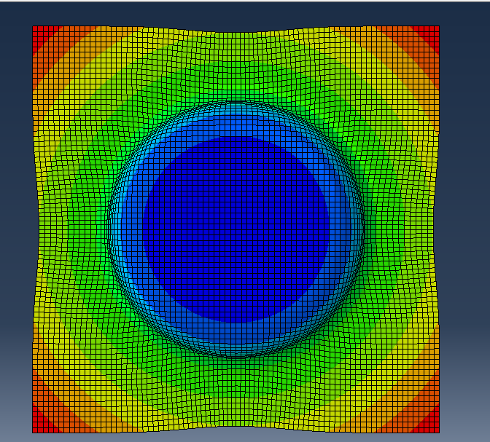
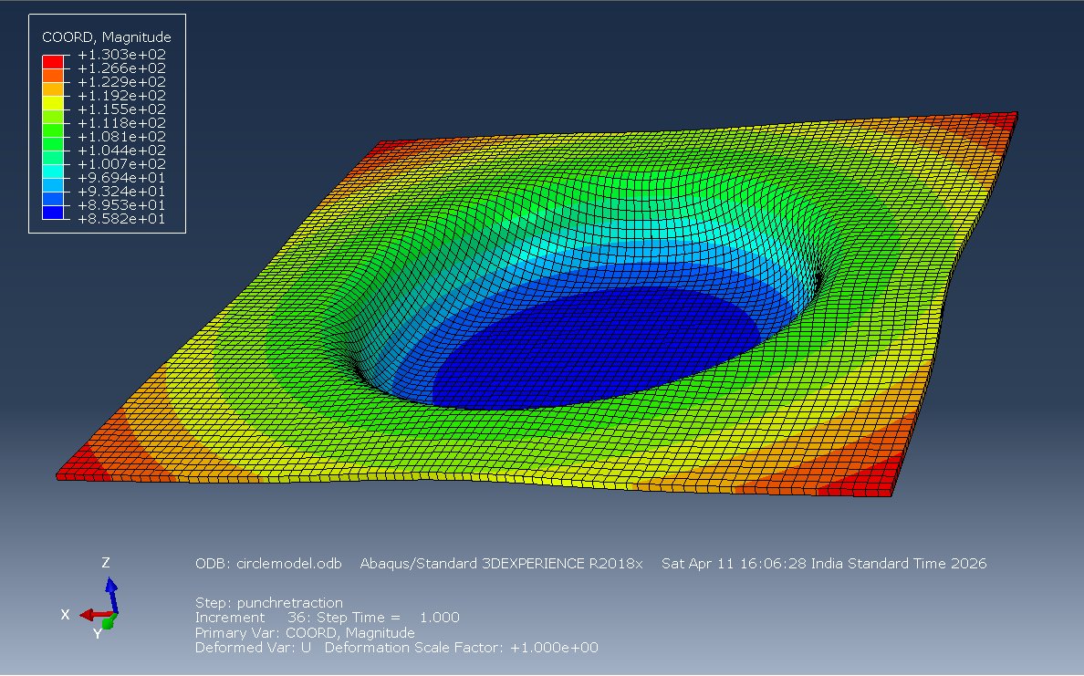
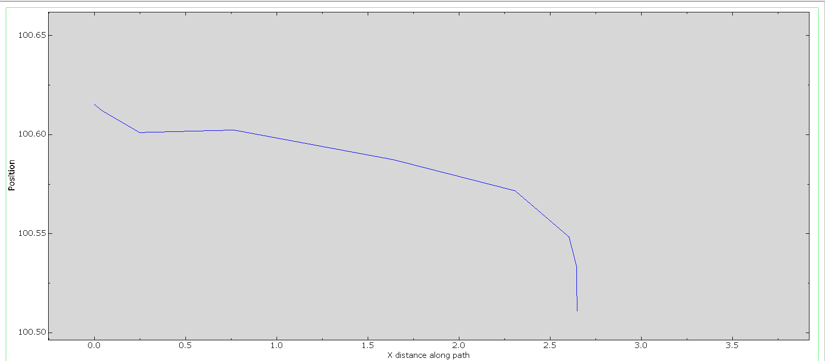
STUDY ON WRINKLE DEFECT
1)BLANK HOLDING FORCE : 5KN
VARIATION ALONG PATH

Slide 9
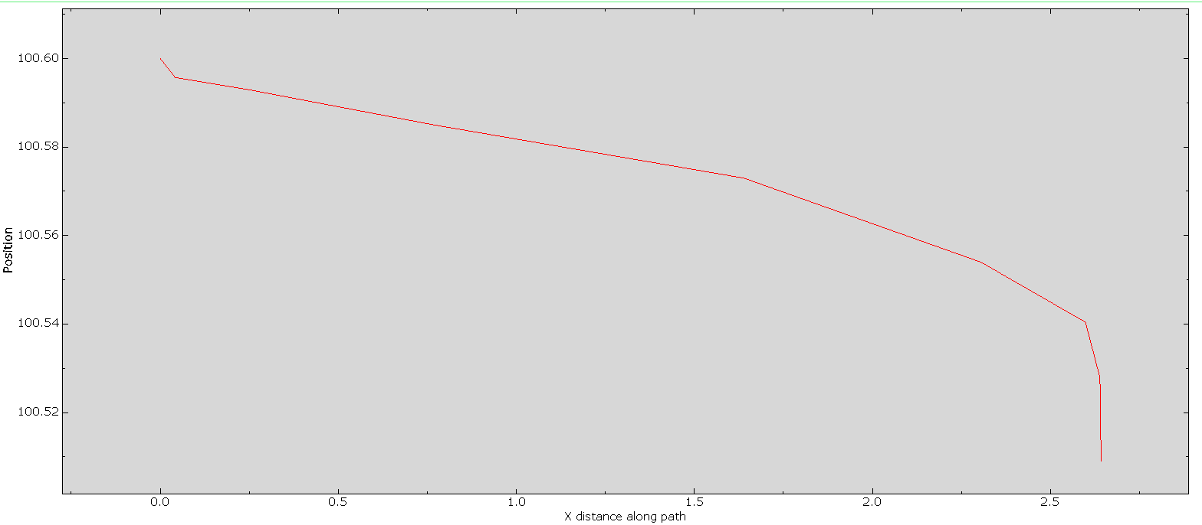
2)BLANK HOLDING FORCE 10 KN
VARIATION ALONG PATH

Slide 10
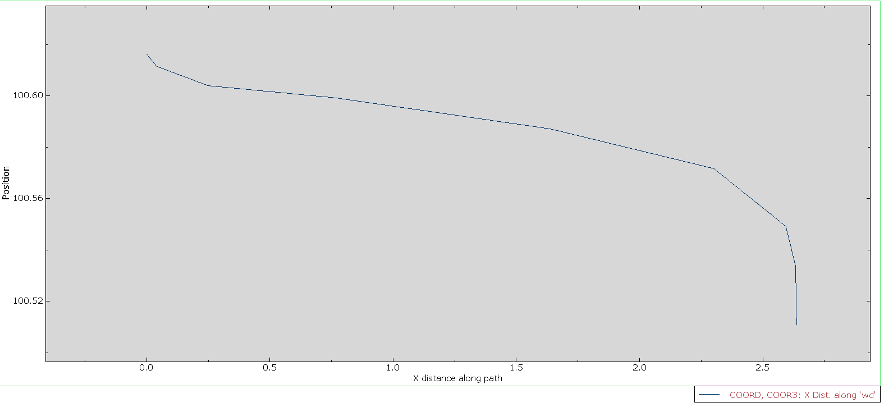
3)BLANK HOLDING FORCE 15 KN
VARIATION ALONG PATH

Slide 11
4)BLANK HOLDING FORCE 20 KN
VARIATION ALONG PATH

Slide 12
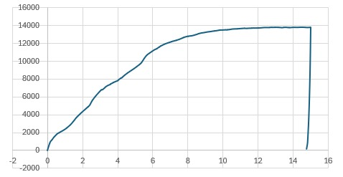
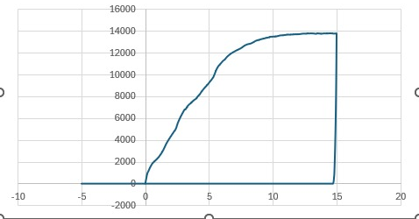
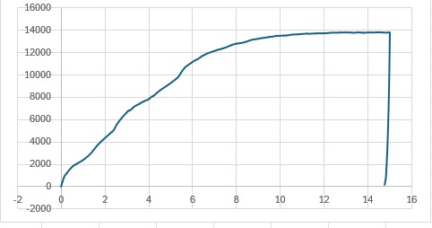
PUNCH LOAD WITH DISPLACEMENT
1)BLANK HOLDING FORCE 5KN
2)BLANK HOLDING FORCE 10KN
3)BLANK HOLDING FORCE 15KN
4)BLANK HOLDING FORCE 20KN

